Slide 1


Your First Car
Mandatory Permit and Label
Notes:
Once the students have watched the video clip, the teacher expands on certain concepts with the help of this presentation.
This presentation deals with the requirement for merchants who sell automobiles to hold a permit and affix a label on every used automobile the merchant puts up for sale or long-term lease.

Slide 2

Mandatory Permit for the Merchant
Issued by the Office de la protection du consommateur (Office)
Requires the merchant to provide security to the Office
  The security is a sum of money that is used to compensate consumers if the merchant fails to abide by its obligations
Must be displayed in the place of business
Notes:
A used automobile can be purchased from an individual or a merchant, that is, a used vehicle dealer (aka "used car dealer").
Merchants who sell automobiles are required to hold a permit from the Office de la protection du consommateur. To obtain this permit, merchants must provide security.
What is security?
It is a type of deposit that serves as a warranty. More specifically, it is a sum of money that could be used to compensate consumers should a merchant fail to abide by its obligations.
For example, the security could be used to reimburse a down payment if the company closes before the consumer takes possession of a vehicle. The security therefore serves as financial protection.
Merchants must display their permit in their place of business and indicate their permit number on every contract they give out to consumers when they purchase a vehicle.

Slide 3
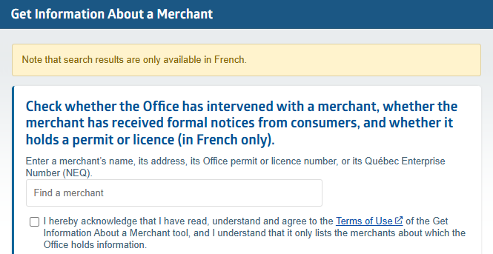



Does the merchant really hold a permit?
Check using the Office's Get Information About a Merchant tool, which provides information on:
the validity of a merchant permit;
the number and nature of any interventions they have received from the Office (notice of non-compliance, criminal prosecution, administrative fine, etc.);
the number of formal notices a merchant has received from consumers.
Notes:
To make sure a merchant really holds a permit, consumers should refer to the Get Information About a Merchant tool on the Office de la protection du consommateur website.
The teacher goes to the tool's webpage and asks the students to name local or regional car dealerships to check the available information about them, including:
the validity of their permit;
the number and nature of any interventions they have received from the Office (notice of non-compliance, criminal prosecution, administrative fine, etc.);
the number of formal notices they have received from consumers.

Slide 4

Mandatory label affixed to every automobile
Price of the automobile
Complete description (make, model and serial number)
Kilometrage indicated by the odometer reading and actual kilometrage, if different
Vehicle category (A, B, C or D) for the warranty of fitness
Indication that you may, on request, obtain the name and telephone number of the most recent owner other than the merchant
Notes:
Merchants must affix a label on each used vehicle they put up for sale or for lease. This label contains details that will help you make an informed decision. It is therefore very important to read it.
Information listed on the label
The label must contain the following information:
the price of the vehicle;
its complete description (model year, serial number, make, model, engine displacement);
the number of kilometres indicated on the odometer and the actual of number of kilometres the vehicle has travelled, if different;
the vehicle category (A, B, C or D), for the warranty of fitness the merchant must provide, under the Consumer Protection Act;
an indication that you may, on request, obtain the name and telephone number of the most recent owner other than the merchant.

Slide 5
If applicable, the label must also indicate:
Characteristics of the manufacturer's warranty
Description of any repairs made by the merchant
Information regarding prior use of the vehicle
Identity of the business or public body that previously owned or leased the vehicle
Indication that the merchant will provide a mechanical inspection certificate if one is required to register the vehicle, e.g., it is from outside Québec or has been declared a total loss
the fact that the vehicle has been declared a “seriously defective automobile” by a court of law
Notes:
Information listed on the label (suite)
If applicable, the label must also indicate:
details regarding the manufacturer's or merchant’s warranty, if it is still valid;
a description of any repairs made since the vehicle has been in the merchant’s possession;
information regarding prior use of the vehicle if it was used as a taxi, a driving school vehicle, a rental vehicle, a police vehicle, an ambulance or a courtesy or demo vehicle;
the identity of the business or public body that owned or leased the vehicle;
an indication that the merchant will provide a mechanical inspection certificate if one is required to register the vehicle, e.g., it is from outside Québec or has been declared a total loss;
the fact that the vehicle has been declared a “seriously defective automobile” by a court of law.

Slide 6
Delivery of the label
Merchants are also required to give the label to the consumers who purchase a vehicle.
If the car is purchased from an individual, there is obviously no label on the vehicle, nor is there a road vehicle dealer's permit.
Notes:
Delivery of the label:
The merchant is also required to give you the label when you purchase or lease the vehicle. All the information contained therein is an integral part of the contract, with the exception of the sale price and the warranty details, which may be modified.
If the car is purchased from an individual, there is obviously no label on the vehicle, nor is there a road vehicle dealer's permit.

Slide 7
In teams, answer questions 2 to 5 on the student worksheet.

